Slide 1
6
TECHNIQUES OF INTEGRATION

Slide 2
Contents
6.1 Integration by Parts
6.5 Approximate Integration
6.6 Improper Integrals

Slide 3
TECHNIQUES OF INTEGRATION
6.1
Integration by Parts
In this section, we will learn:
How to integrate complex functions by parts.

Slide 4
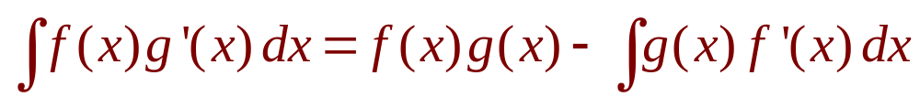
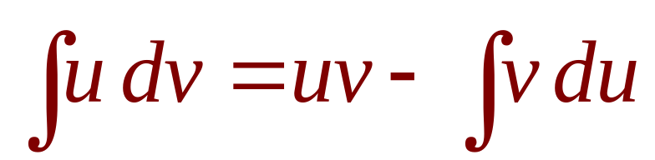
INTEGRATION BY PARTS
Formula 2
  Let u = f(x) and v = g(x).
  Then, the differentials are:
  du = f’(x) dx and dv = g’(x) dx
Thus, by the Substitution Rule, the formula for integration by parts becomes:
Notes:
Let u = ?; dv = ?
How to choose u and dv to make the resulting integral simpler.
The analogy with u-substitution: u-substitution is “undoing” the Chain Rule, and integration by parts is “undoing” the Product Rule.

Slide 5
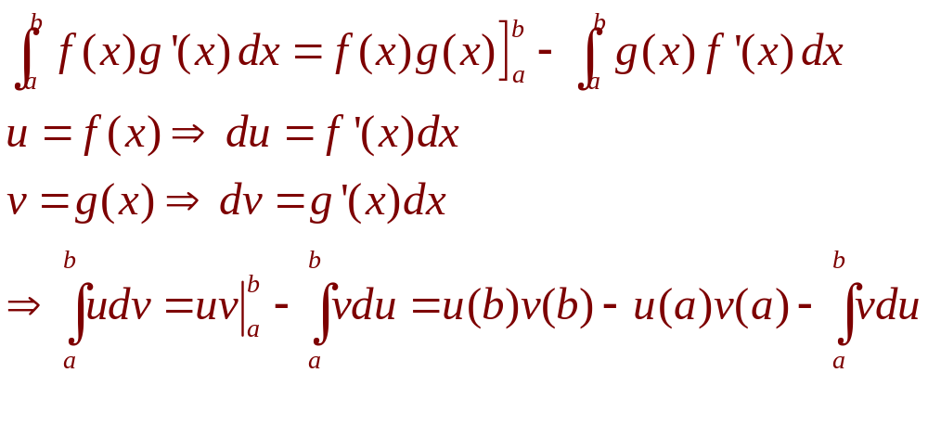
INTEGRATION BY PARTS
Formula 6
Evaluating both sides of Formula 1 between a and b, assuming f’ and g’ are continuous, and using the FTC, we obtain:

Slide 6
INTEGRATION BY PARTS
Example
Find ∫ x sin x dx

Slide 7
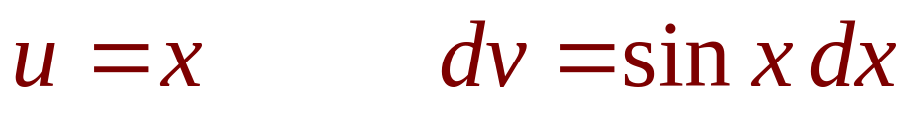

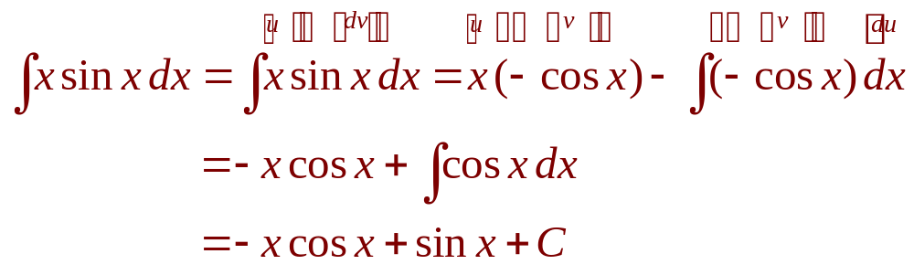
INTEGRATION BY PARTS
Example
Let
Then,
Using Formula 2, we have:

Slide 8
INTEGRATION BY PARTS
Example 4
Evaluate ∫ e^{x}sinxdx
  e^{x} does not become simpler when differentiated.
  Neither does sinx become simpler.

Slide 9
INTEGRATION BY PARTS
E. g. 4—Equation 4
Nevertheless, we try choosing
u = e^{x} and dv = sinxdx
  Then, du = e^{x} dx and v = – cosx.

Slide 10
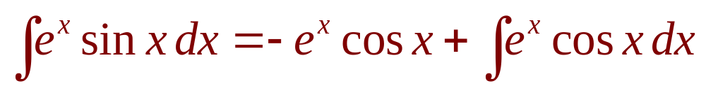
INTEGRATION BY PARTS
Example 4
So, integration by parts gives:

Slide 11
INTEGRATION BY PARTS
Example 4
The integral we have obtained, ∫ e^{x}cos x dx,
is no simpler than the original one.
  At least, it’s no more difficult.
  Having had success in the preceding example integrating by parts twice, we do it again.

Slide 12
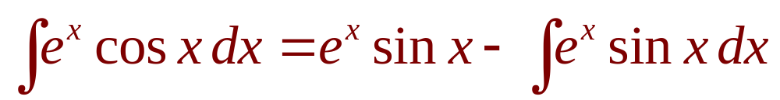
INTEGRATION BY PARTS
E. g. 4—Equation 5
This time, we use
u = e^{x} and dv = cosxdx
Then, du = e^{x}dx, v = sinx, and

Slide 13
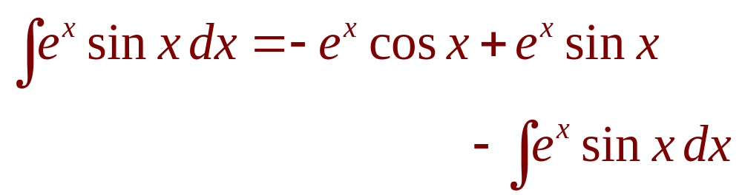
INTEGRATION BY PARTS
Example 4
However, if we put the expression for
∫ e^{x} cos x dx from Equation 5 into Equation 4, we get:
  This can be regarded as an equation to be
  solved for the unknown integral.

Slide 14
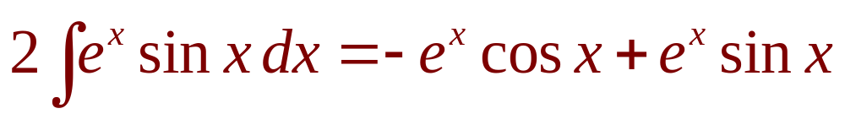
INTEGRATION BY PARTS
Example 4
Adding to both sides ∫ e^{x} sin x dx,
we obtain:

Slide 15
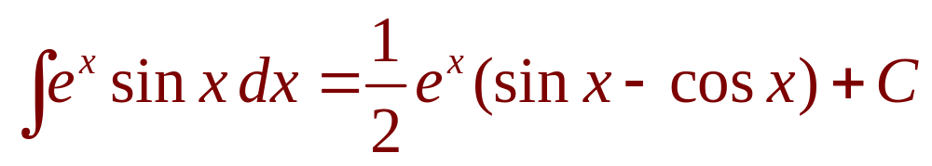
INTEGRATION BY PARTS
Example 4
Dividing by 2 and adding the constant
of integration, we get:

Slide 16
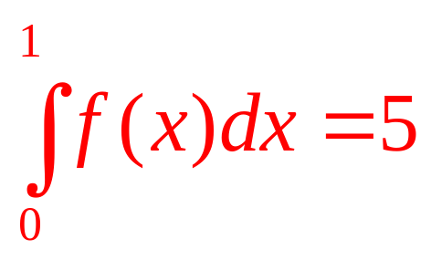
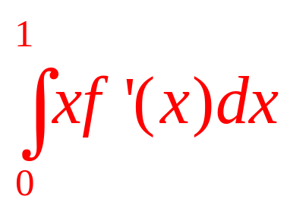
Suppose f(x) is continuous and Differentiable, f(1)=4 and Find
a | 4/5
b | 5/4
c | 1
d | None of the others
e | -1

Slide 17
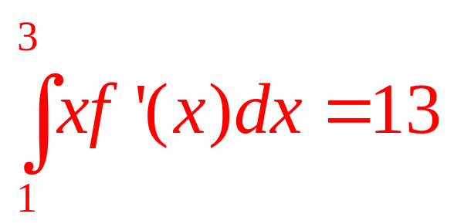
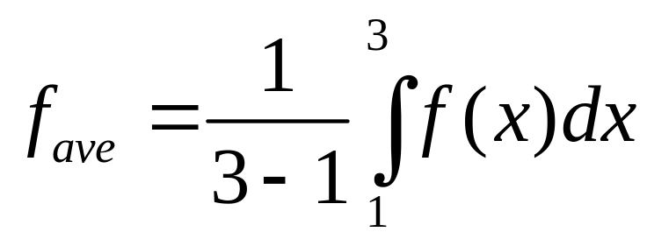
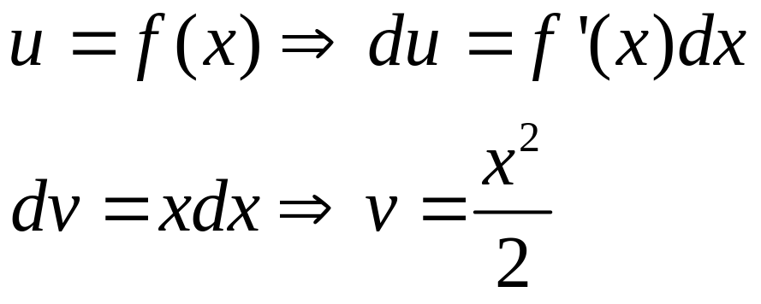
Suppose f(x) is continuous and differentiable, f(1)=3, f(3)=1 and What is the average value of f on the interval [1,3]?

Slide 18
TECHNIQUES OF INTEGRATION
6.5
Approximate Integration
In this section, we will learn:
How to find approximate values
of definite integrals.
Notes:
Use Riemann Sums to approximation with left-end point, right-end point, midpoint as sample point.
The Trapezoidal rule and Simpson’s rule.
Comparison of the accuracies of the different approximating techniques and error bounds.

Slide 19
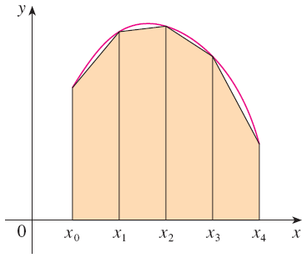
TRAPEZOIDAL RULE
The reason for the name can be seen
from the figure, which illustrates the case f(x) ≥ 0.

Slide 20
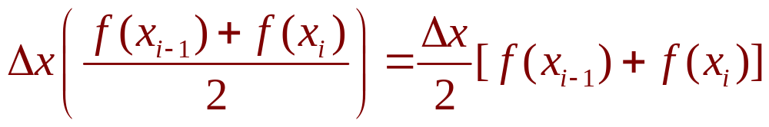
TRAPEZOIDAL RULE
The area of the trapezoid that lies above
the i th subinterval is:
  If we add the areas of
  all these trapezoids,
  we get the right side of
  the Trapezoidal Rule.

Slide 21
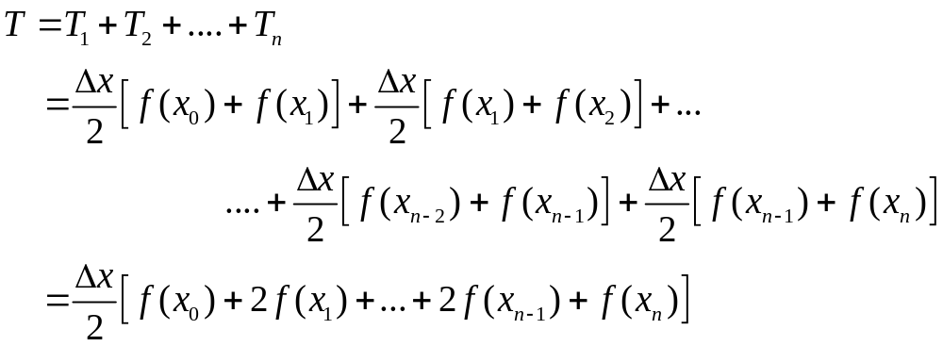

Slide 22
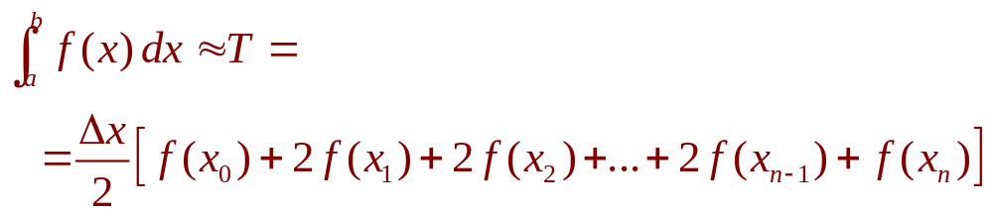
THE TRAPEZOIDAL RULE
where ∆x = (b – a)/n and x_{i} = a + i ∆x , i = 1,2,…, n

Slide 23
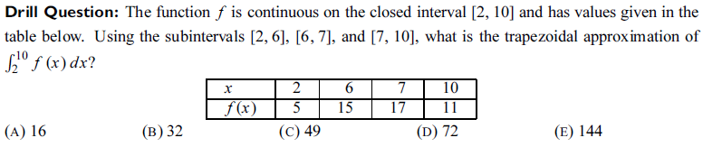
Answer: 2(C)

Slide 24
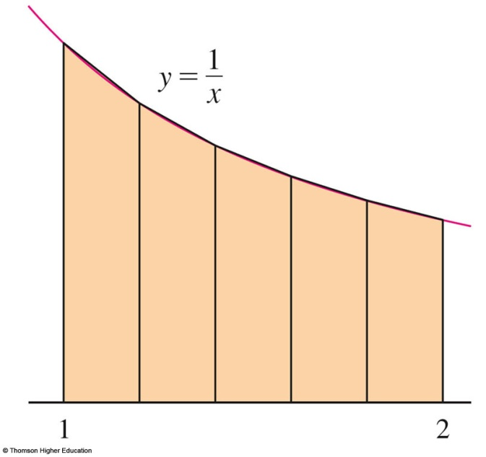
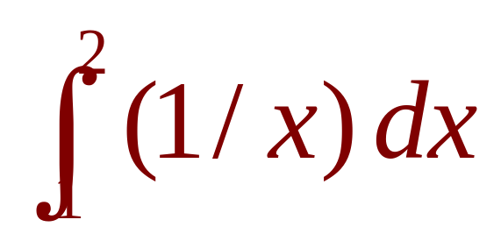
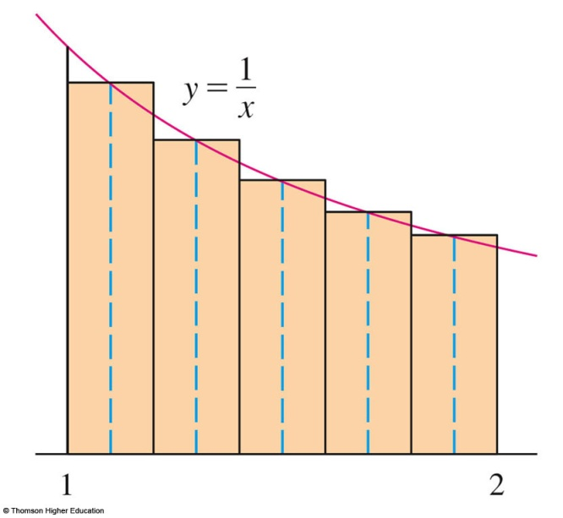
APPROXIMATE INTEGRATION
Example 1
Approximate the integral
with n = 5, using:
a. Trapezoidal Rule
b. Midpoint Rule

Slide 25
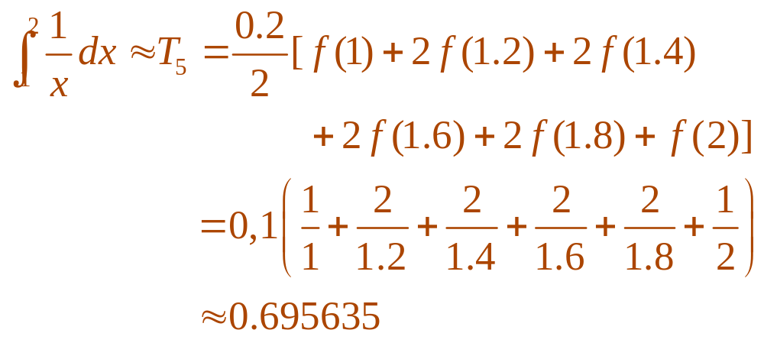
APPROXIMATE INTEGRATION
Example 1a
With n = 5, a = 1 and b = 2,
we have: ∆x = (2 – 1)/5 = 0.2
  1, 1.2, 1.4, 1.6, 1.8, 2
  So, the Trapezoidal Rule gives:

Slide 26
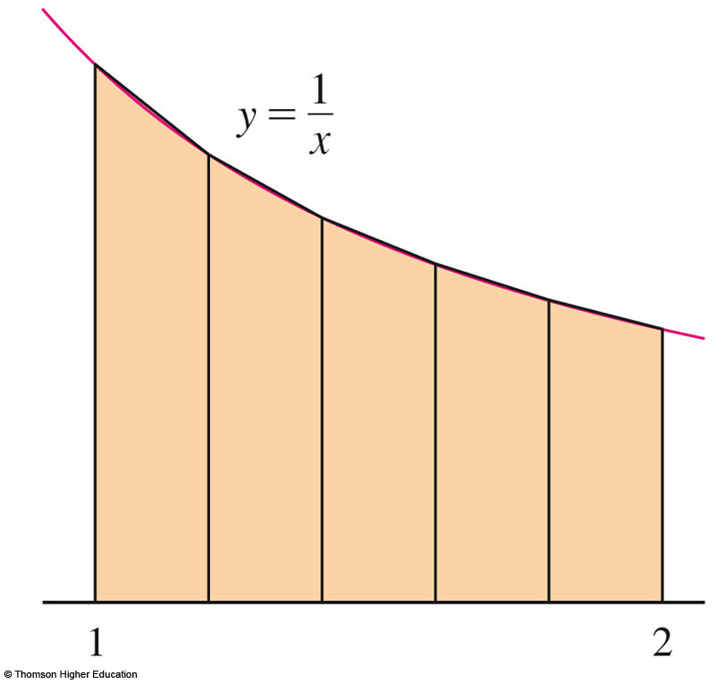
APPROXIMATE INTEGRATION
Example 1 a
The approximation is illustrated here.

Slide 27

APPROXIMATE INTEGRATION
Example 1 b
The midpoints of the five subintervals
are: 1.1, 1.3, 1.5, 1.7, 1.9

Slide 28
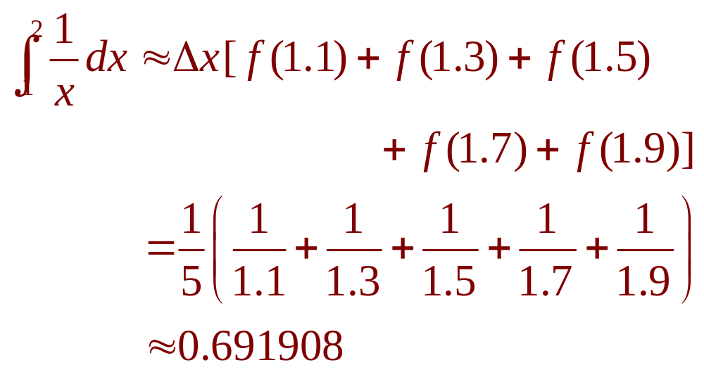
APPROXIMATE INTEGRATION
Example 1 b
So, the Midpoint Rule gives:

Slide 29
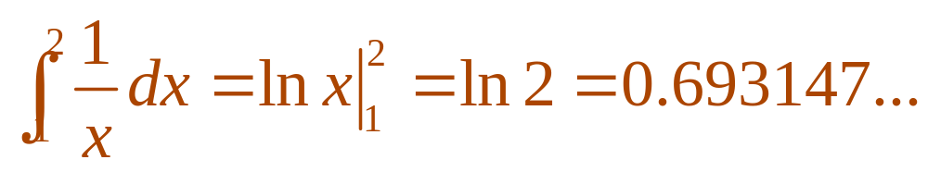
APPROXIMATE INTEGRATION
In Example 1, we deliberately chose
an integral whose value can be computed explicitly so that we can see how accurate
the Trapezoidal and Midpoint Rules are.
  By the FTC,

Slide 30
APPROXIMATE INTEGRATION
From the values in Example 1, we see that
the errors in the Trapezoidal and Midpoint Rule approximations for n = 5 are:
E_{T} ≈ – 0.002488
E_{M} ≈ 0.001239
M
Đ
T

Slide 31
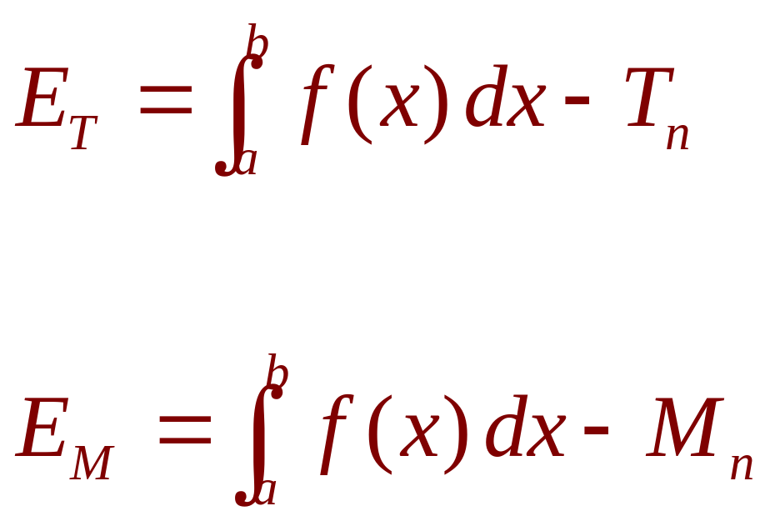
APPROXIMATE INTEGRATION
In general, we have:

Slide 32
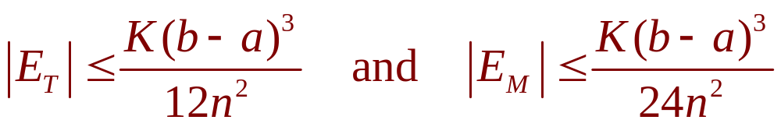
ERROR BOUNDS
Estimate 3
Suppose | f’’(x) | ≤ K for a ≤ x ≤ b.
If E_{T} and E_{M} are the errors in the Trapezoidal and Midpoint Rules, then

Slide 33
SIMPSON’S RULE
This is called Simpson’s Rule—after
the English mathematician Thomas Simpson (1710–1761).

Slide 34
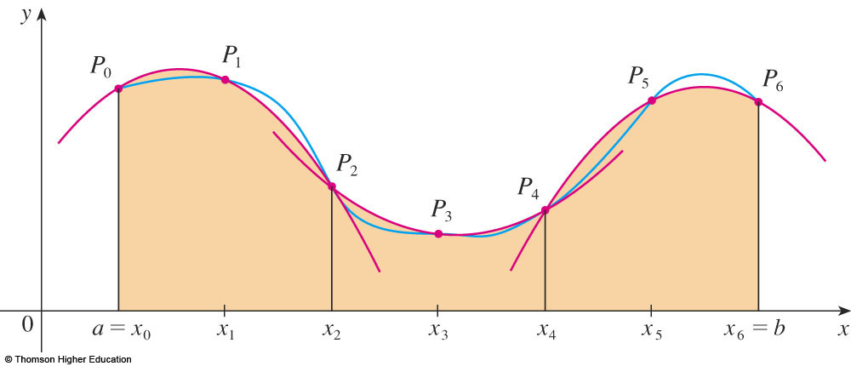
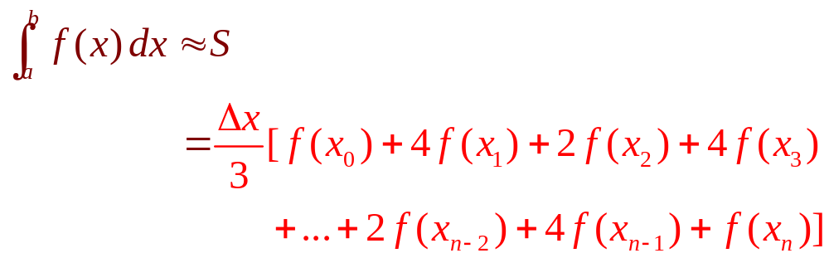
SIMPSON’S RULE
where n is even and ∆x = (b – a)/n.

Slide 35
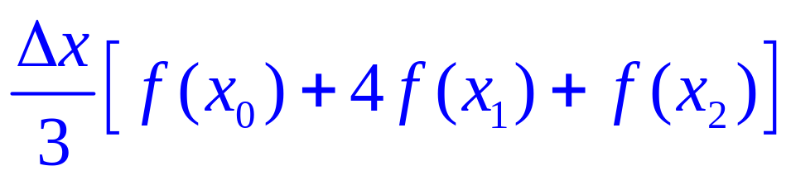
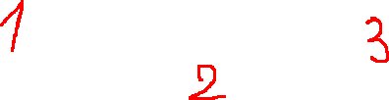
APPROXIMATE INTEGRATION
This means that the area under the parabola through P₀, P₁, and P₂ from x = x₀ to x = x₂ is still:

Slide 36
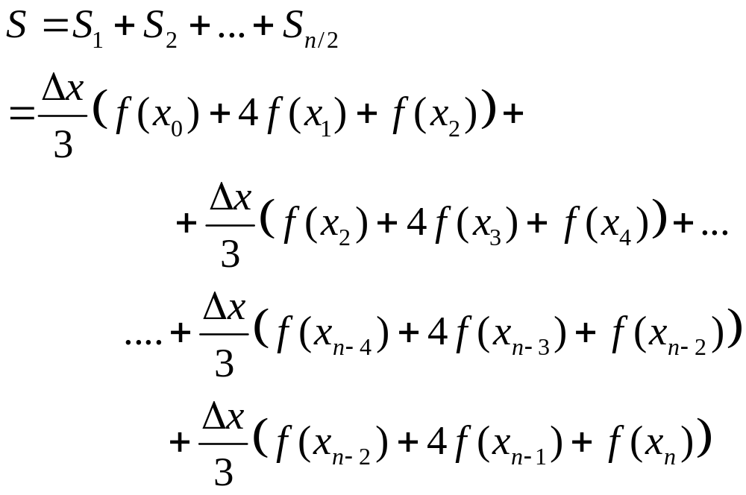

Slide 37
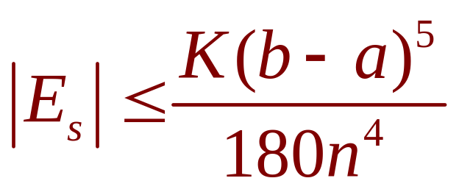
ERROR BOUND (SIMPSON’S RULE)
Estimate 4
Suppose that | f ⁽⁴⁾(x) | ≤ K for a ≤ x ≤ b.
If E_{s} is the error involved in using
Simpson’s Rule, then

Slide 38
SIMPSON’S RULE
Example 4
Use Simpson’s Rule with n = 10 to approximate

Slide 39
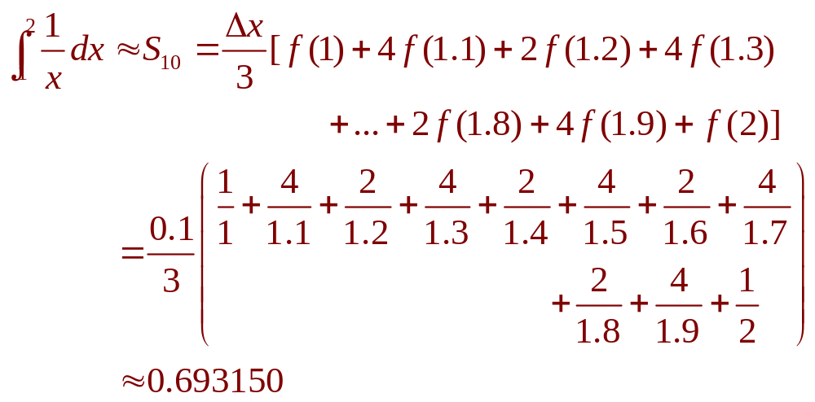
SIMPSON’S RULE
Example 4
Putting f(x) = 1/x, n = 10, and ∆x = 0.1 in Simpson’s Rule, we obtain:

Slide 40
SIMPSON’S RULE
In Example 4, notice that Simpson’s Rule gives a much better approximation
(S₁₀ ≈ 0.693150) to the true value of the integral (ln 2 ≈ 0.693147) than does either:
  Trapezoidal Rule (T₁₀ ≈ 0.693771)
  Midpoint Rule (M₁₀ ≈ 0.692835)

Slide 41
TECHNIQUES OF INTEGRATION
6.6
Improper Integrals
In this section, we will learn:
How to solve definite integrals
where the interval is infinite and
where the function has an infinite discontinuity.
Notes:
What is the improper integrals of type I, II?
A careful definition of convergence and divergence as related to improper integrals of type I, II.
The comparison theorem to determine that improper integrals convergence and divergence.

Slide 42
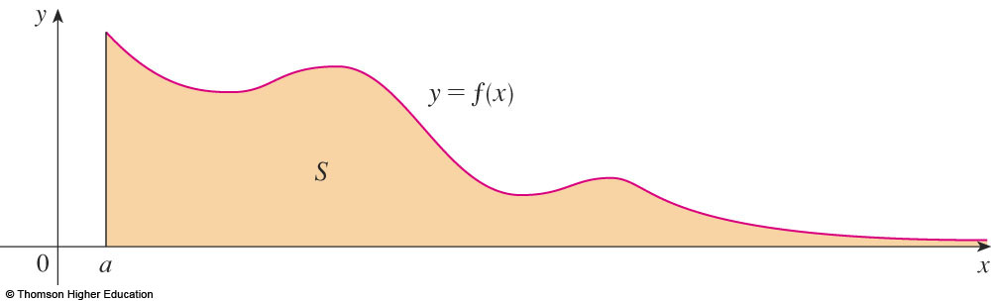

Slide 43
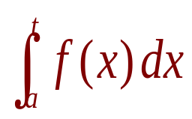
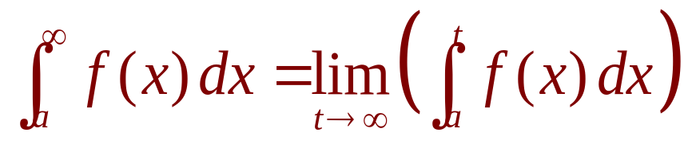

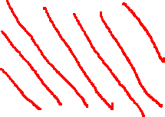
IMPROPER INTEGRAL OF TYPE 1
Definition 1a
If exists for every number t ≥ a, then
provided this limit exists (as a finite number).
t

Slide 44
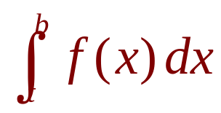
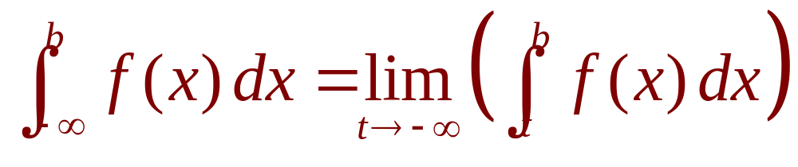
IMPROPER INTEGRAL OF TYPE 1
Definition 1b
If exists for every number t ≤ b, then
provided this limit exists (as a finite number).

Slide 45
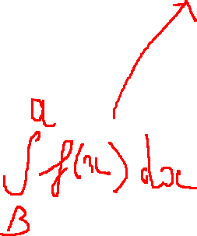
B
a

Slide 46
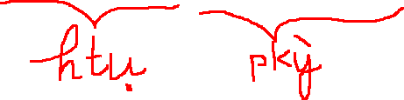
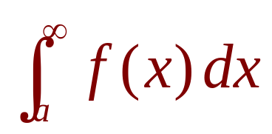
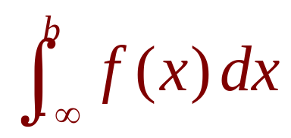
CONVERGENT AND DIVERGENT
Definition 1b
The improper integrals and
are called:
  Convergent if the corresponding limit exists.
  Divergent if the limit does not exist.

Slide 47
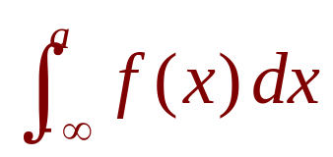
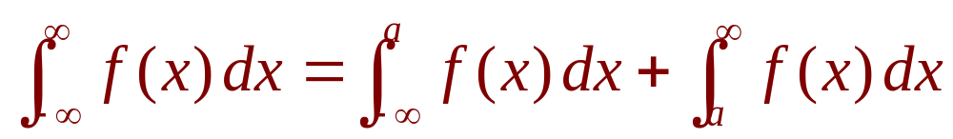
IMPROPER INTEGRAL OF TYPE 1
Definition 1c
If both and are convergent, then we define:
  Here, any real number a can be used.

Slide 48

a

Slide 49
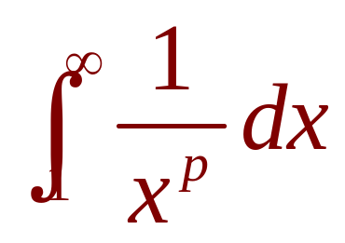
IMPROPER INTEGRALS OF TYPE 1
Example 4
For what values of p is the integral
convergent?
  We know from Example 1 that, if p = 1,
  the integral is divergent.
  So, let’s assume that p ≠ 1.

Slide 50
IMPROPER INTEGRALS OF TYPE 1
Definition 2
We summarize the result of Example 4
for future reference:
is:
  Convergent if p > 1
  Divergent if p ≤ 1
Notes:
Basic integral

Slide 51

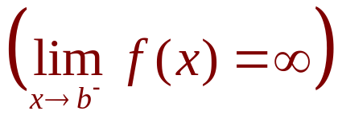



IMPROPER INTEGRAL OF TYPE 2
Definition 3a
If f is continuous on [a, b) and is discontinuous at b
then
if this limit exists (as a finite number).

Slide 52




IMPROPER INTEGRAL OF TYPE 2
Definition 3b
If f is continuous on (a, b] and is discontinuous at a
then
if this limit exists (as a finite number).

Slide 53

IMPROPER INTEGRAL OF TYPE 2
Definition 3b
The improper integral is called:
  Convergent if the corresponding limit exists.
  Divergent if the limit does not exist.

Slide 54





IMPROPER INTEGRAL OF TYPE 2
Definition 3c
If f has a discontinuity at c, where a < c < b, and
both and are convergent, then we define:

Slide 55



COMPARISON THEOREM
Suppose f and g are continuous functions with f(x) ≥ g(x) ≥ 0 for x ≥ a.
  If is convergent, then
  is convergent.
  If is divergent, then
  is divergent.
Notes:
For example…

Slide 56
p.354: 5 – 32 ; 41 – 46
p. 345: 6; 8; 10
p.311: 4 – 20 .
Thanks

